Slide 1


SAP BTP Training
Cloud Foundry Training

Slide 2

DISCLAIMER
The training content and delivery of this presentation is confidential, and cannot be recorded, or copied and distributed to any third party, without the written consent of Anubhav Trainings

Slide 3

LEARNING OBJECTIVES
Working with microservice
Create a Simple web service
Create a CURDQ Application using Spring boot and PostgreSQL
Explain How to Run PostgreSQL in SAP CF,
Manifest.yml file and Deploy application to CF
--BREAK--
Project Management
Working with git and git hub
Manage application lifecycle using Jenkins CI/CD

Slide 4
HANDS-ON- CREATE FIRST SPRING MICROSERVICE
Design a Microservice which returns data for different vendors.
Browser
ServletInitializer
Application
@RestController
VendorController
@Component
Vendor
Solution:
https://github.com/soyuztechnologies/01RestService.git

Slide 5
JDBC – Java Database Connectivity – SQL
Hibernate is a definition of how to talk to database but the implementation is done by frameworks like eclipse link, or JPA – Java persistence API Spring JPA –
No SQL is required
Out-of-box implementation for CURDQ (Create Update, Read, Delete, Query)
ORM – Object Relation Modeling
Class - vendor
Table = VENDOR_TABLE
Java Object
Vendor 1
Java Object
Vendor 2

Slide 6
HANDS-ON: CREATE CURDQ APP FOR LOCAL POSTGRESQL
Design an Entity of Vendor and its address in the Spring boot app
Connect the application to the PostgreSQL in local system
Implement and test all CURDQ operations using REST API
Id
firstName
lastName
companyName
Website
emailId
gstNo
Vendor
Id
type
street
city
country
region
Address
1
*

Slide 7
HANDS-ON: CREATE CURDQ APP FOR CF POSTGRESQL
Create a PostgreSQL Service in SAP CF
Connect to the service and test the app
# ===============================
# = DATA SOURCE
# ===============================
# Set here configurations for the database connection
spring.datasource.url=jdbc:postgresql://connectionurl:5432/mufpwelo
spring.datasource.username=userName
spring.datasource.password=password
spring.datasource.driver-class-name=org.postgresql.Driver
spring.jpa.show-sql=true
# Hibernate ddl auto (create, create-drop, update): with "create-drop" the database
# schema will be automatically created afresh for every start of application
spring.jpa.hibernate.ddl-auto=create
# Allows Hibernate to generate SQL optimized for a particular DBMS
spring.jpa.properties.hibernate.dialect=org.hibernate.dialect.PostgreSQLDialect

Slide 8
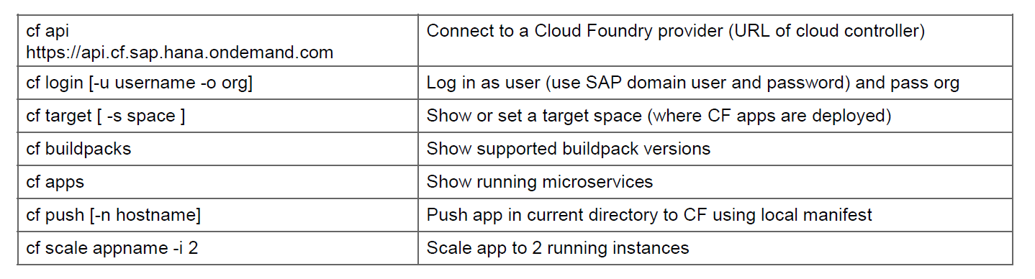
HANDS-ON: DEPLOY CURDQ APP IN CF
Add manifest.yml file to the app
Deploy the app to CF
---
applications:
- name: dbboot
random-route: true
memory: 1024M
path: /target/02dbboot-0.0.1-SNAPSHOT.war
buildpacks:
- java_buildpack
Solution:
https://github.com/soyuztechnologies/02dbboot.git

Slide 9
HANDS-ON: CREATE A GITHUB REPOSITORY
Create an Account on https://www.github.com
Push your code to github

Slide 10
CONFIGURE CI PIPELINE
Create a CI pipeline using Jenkins
Configure Jenkins Server
Install Git Repository Plugin and Test(GitHub plugin)
Install Maven Plugin and Link to Jenkins( Maven Integration plugin )
Install Maven in System where Jenkins is Running
Set Classpath(M2_Home=Installation, M2=Bin File) and Test mvn –version
Install Maven Integration and Maven Invoker Plugin
Global Tool Configuration, Give Path M2_Home and Path
Test the Git and Maven, location of war file is in:
Install Cloud Foundry Plugin and Add to the Jenkins Task in Post build Actions
6. Provide Details of :
Cloud Foundry: API, Email and Password, Organization and Space is needed
7. Create a manifest.yml file and add content of path, application name etc.
8. Add Build Triggers and enable ‘Build whenever a SNAPSHOT dependency is built’
and Poll SCM with * * * * * for building every minute

Slide 11

Summarize
LET’S SUMMARISE!

Slide 12

Summarize
End of Day 4

Slide 14


We’re committed to empower you to be
#FutureReady
through powerful training solutions.
We build the workforce of the future.
250+
Corporate Clients
30,000+
Learners Trained
25000+
Learners Placed
FREE WEBINARS
Sign up for free webinars with industry experts every fortnight!
Enroll Now!
Contact us today!
https://anubhavtrainings.com

